Slide 1

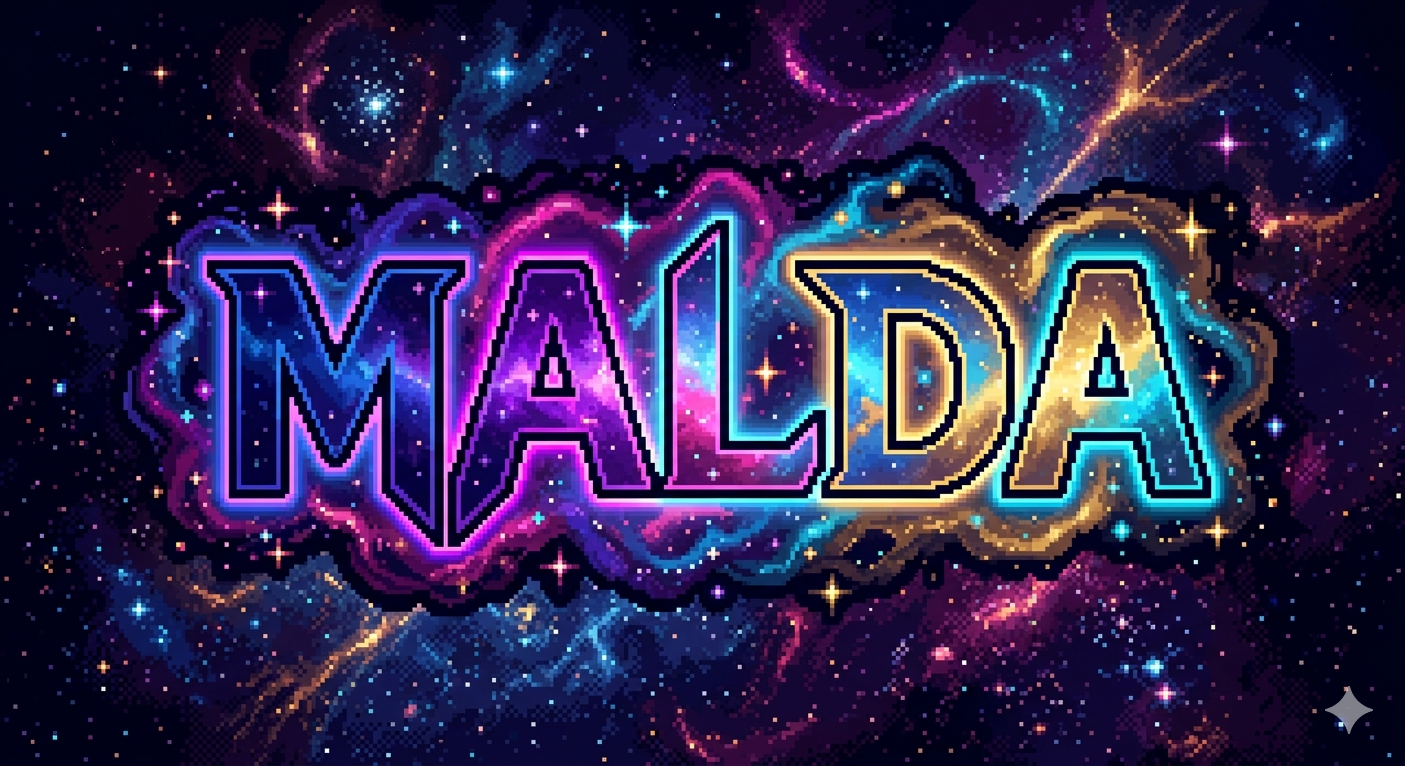

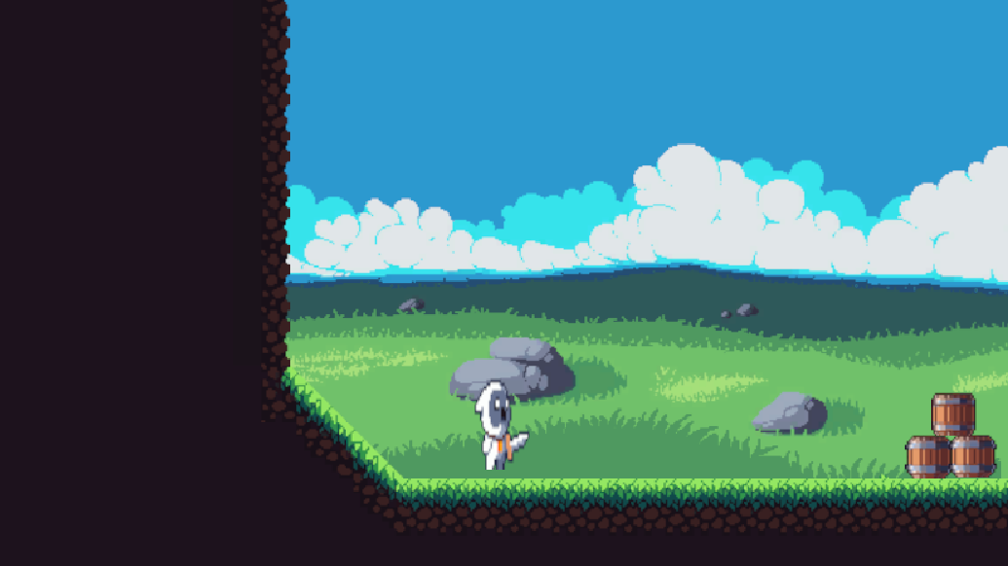
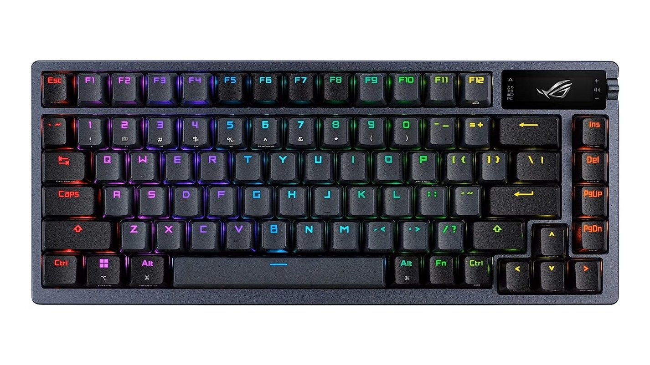
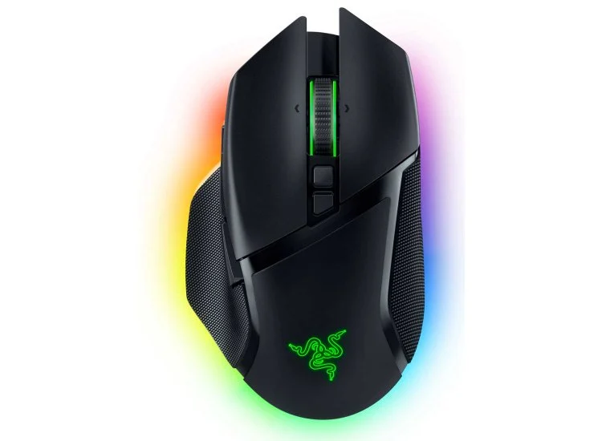
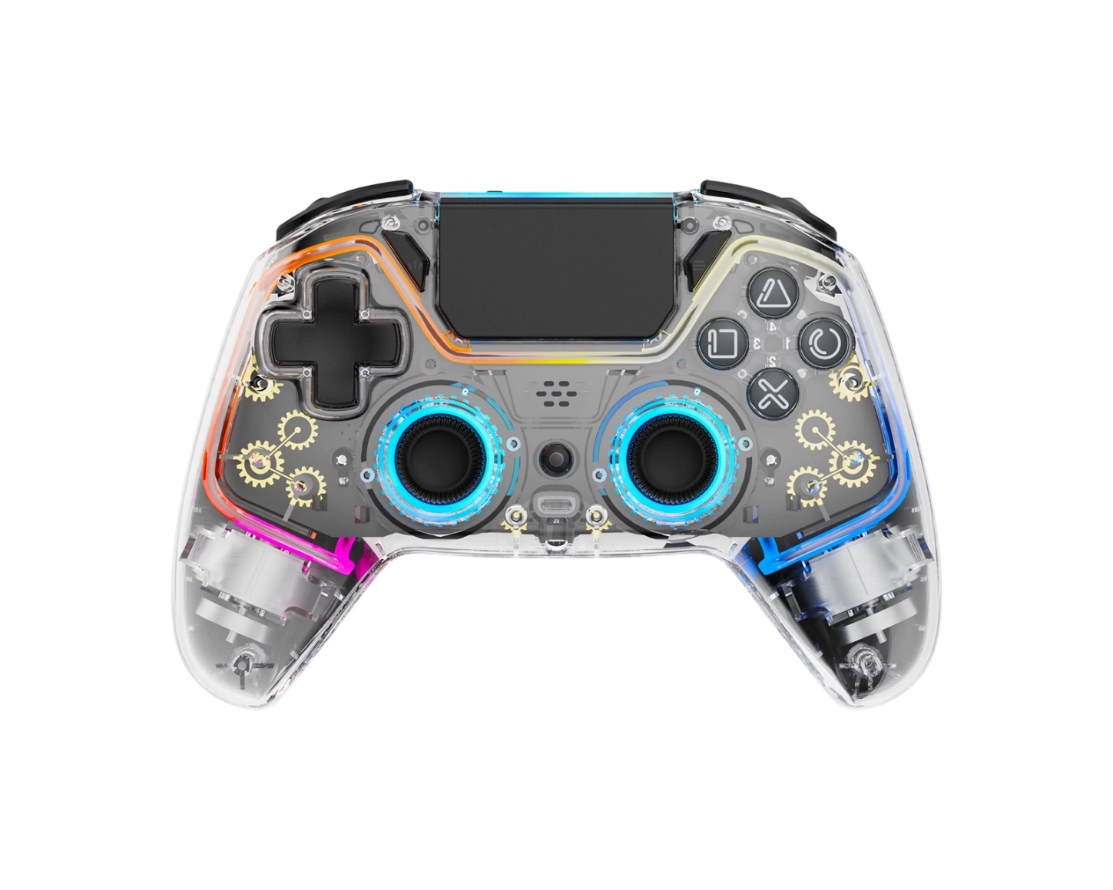
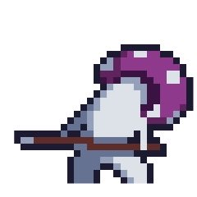
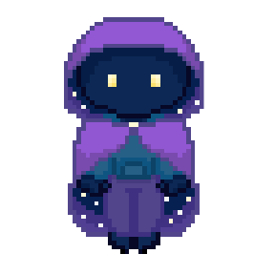
MALDA
Anthony Chapman, Eric Moore, Noah Turrock, Rachel Mohamed
Dept. Of Computer Science and Information Technology
Abstract
Technology
Future Work
Malda is a 2D Puzzle-Platforming game that sees players navigate platforms, fight enemies, and overcome obstacles to reach their goal. The game will hold 6 playable levels. Upon completing a level, players will be awarded a new item to help them continue their journey. Some levels require items from previous levels to be completed. Levels may include optional portions that require items from later in the game to discover. Malda will feature a minimalistic pixel art style.
Malda players will need to be creative with their use of items, sometimes in combination with each other, in order to succeed. As players make it further in the game, they will find their technical platforming skills tested.
Malda will be developed through Unity, a full-fledged platform for creating 2D and 3D video games and applications with C# programming language.
Our code will be edited using Microsoft Visual Studio Code, which is another development platform that is capable of using a wide range of plugins and programming languages.
Team members will be collaborating using Github, Git, and GitDesktop; A developer platform used to consolidate project adjustments and changes made by each team member for ease of development.
Our team uses the social media platform Discord in order to effectively communicate any ideas or changes regarding the project.
Google Gemini is an artificial intelligence tool that can be used for a variety of purposes, including image generating and chiptune themed sound development.
Some images may be edited using Gimp, a free open-source image editor.
Currently, there is no definite agreement on whether to continue the work after the semester. However, it is not entirely ruled out either.
The universe of Malda is based on the tree of life. With respect to its philosophical, mythical, and religious history, there exists some ideas to add additional levels and tailor each level design based on what each focal point of the Tree Of Life represents. While our game aims for 6 levels in time for our senior project due date, the Tree Of Life holds anywhere from 7 to 11 focal-points, depending on which religion you reference from. Thus, the game will be entirely revamped and scaled to feel more like a full-bodied video game.
Further future development will require new techniques and feature implementations that otherwise did not make it in the final demo or presentation. This can include adding additional tools to the player arsenal and maneuverability within the game.
Additionally, artwork and soundtracks originally borrowed from CraftPix or created with the help of generative AI will be redone to match the art and music style of the game as time becomes significantly more available.
Figure 2: Our video game will be playable on a windows 10 operating system or higher; Showing a temporary character for animation testing.
Story
Malda, a being of the cosmos, has been sent to repair the connections between worlds, collectively known as the Tree of Life. There have been reports of 6 different worlds attached to these branches and roots, plunging into chaos as trickster beings have managed to mess with them. As you reach the center of the tree, you find it requires porthole keys to unlock your way to the next. Each key can be found inside the world you enter for each level.
Figure 3: the above images showcase that our video game will have keyboard and mouse playability.
Design
Figure 4: the above image showcases that our video game will have controller support for playability.
References
Malda will be themed and designed as a 2D puzzle-platforming video game that takes in account a feel for nostalgia. The game itself will see 6 playable levels, each representing a different world attached to the Tree Of Life and housing different types of enemies.
All sound effects and background music will be following the chiptune genre.
Artwork comes from CraftPix.net, with some items being mildly modified and others being heavily modified to fit the theme of our game.
Artwork: https://craftpix.net/
Design: https://procreate.com/
Tutorials: https://youtube.com/
Development: https://unity.com/
Scripting: https://code.visualstudio.com/
Collaboration: https://github.com/
Communication: https://discord.com/
Acknowledgements
Figure 1: The image above displays the level one’s basic enemy. Our first enemy is the Little Mushroom Guy and is a standard free-roaming creature that will charge at and attack the player if they get near enough.
Figure 5: This character is the original concept art of the character that you will play as throughout the game.
We would like to thank Dr. Karen Meisch for her support of students in the College of Science, Technology, Engineering & Mathematics, and Dr. Leong Lee for his support of students in the Department of Computer Science and Information Technology.

